Slide 1
Chapter 4:
The respiratory system allows gas exchange

Slide 2
4.1 Structure of the respiratory system
The structure of the respiratory system allows the efficient flow of air into and out of the lungs so that gas exchange can occur between the air and the blood.
Nose, pharynx and larynx
Air enters the body through the mouth and nose. The lining of the nose and nasal cavity is lined by mucous membranes. As the air passes over the membranes, it is warmed and humidified. There are also hairs and mucus lining the nose. These trap debris, preventing it from reaching the lungs.
The pharynx, or throat, is the region from the nasal cavity to the top of the trachea and oesophagus. Air travels through it before being diverted into the trachea by the epiglottis. During inhalation the epiglottis covers the oesophagus, guiding the air into the trachea; when swallowing, the epiglottis covers the larynx, preventing food from entering it.
The larynx is a cartilage structure joining the pharynx and trachea. The larynx contains the vocal cords, which are mucous membranes that are able to vibrate as air passes over them.

Slide 3
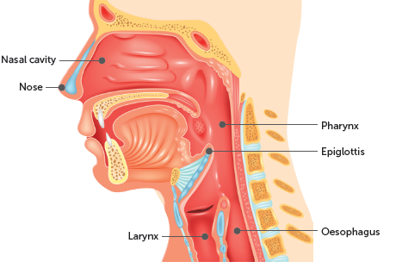
4.1 Structure of the respiratory system
Shutterstock.com/Teguh Mujiono

Slide 4
4.1 Structure of the respiratory system
Trachea
The trachea is also known as the windpipe because it carries the air into and out of the lungs. It is made up of C-shaped cartilage rings that hold the structure open, ensuring air can always pass through it. At its base, the trachea splits into two branches, one branch taking air into each lung.
The epithelial lining of the trachea produces mucus, which is able to trap dust and debris and prevent it from entering the lungs. The cilia that also line the trachea are able to move in a wave-like motion to take the mucus and debris up to the pharynx so that it can be swallowed and digested.

Slide 5
4.1 Structure of the respiratory system
Bronchi
At the end of the trachea, the structure splits into two primary bronchi, one for each lung. These then split further into secondary bronchi which take the air into each lobe of the lung. The secondary bronchi continue to divide, forming tertiary bronchi.
The bronchi are made up of C-shaped cartilage rings.
Bronchioles
When the tertiary bronchi divide, they form smaller airways called bronchioles, which continue to split until they end in millions of terminal bronchioles. Bronchioles are made of smooth muscle and elastin. This allows the bronchioles to control the flow of air in the lungs, expanding when the body needs more oxygen.

Slide 6
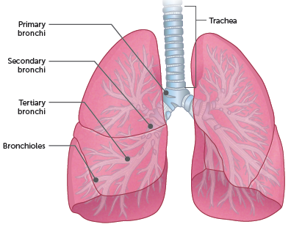
4.1 Structure of the respiratory system

Slide 7
4.1 Structure of the respiratory system
Lungs
Each lung is divided into lobes. The left lung has two lobes; the right lung has three. A membrane, called the pleura, covers the surface of the lungs (the visceral pleura) and also lines the inside of the chest (the parietal pleura). Between these two layers of membrane is a thin layer of pleural fluid.
Inside the lungs the smallest bronchioles open into clusters of tiny air sacs called alveoli. Each alveolus is surrounded by a network of blood capillaries. This is where gases move between the blood in the capillaries and the air in the alveoli. The alveoli are the functional units of the lungs. This makes it possible for the alveoli to be the surface for gaseous exchange, allowing a net flow of oxygen to pass from the airways into the blood and carbon dioxide to pass from the blood into the airways.

Slide 8
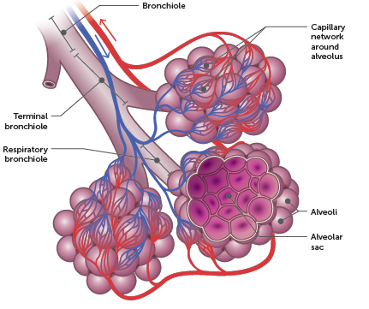
4.1 Structure of the respiratory system

Slide 9
4.2 Mechanics of breathing
The process by which air is moved into and out of the lungs is called ventilation, or breathing. Air flows from places of higher pressure to places of lower pressure; therefore, air flows into and out of the lungs due to differences in air pressure.
Inspiration
The process of taking air into the lungs is called inspiration, or inhalation.
Expiration
Breathing out is called expiration, or exhalation.
The diaphragm and intercostal muscles work together to change the volume – and therefore pressure – of the lungs, resulting in airflow into or out of the lungs.

Slide 10
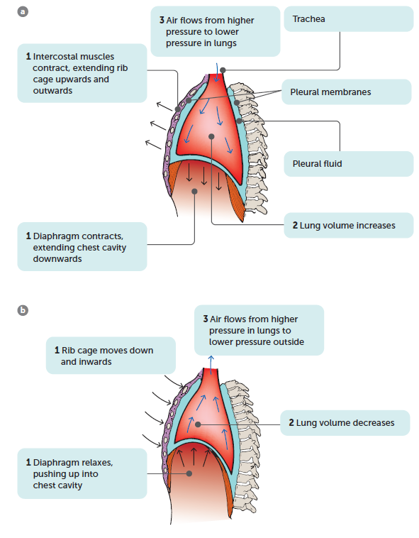
4.2 Mechanics of breathing
Sequence of events that occur during
a inspiration
b expiration
Notes:
<

Slide 11
4.3 Gas exchange
Structure of the lungs and gas exchange
The lungs are suited to their gas exchange function because:
The alveoli give the lungs a huge internal surface area, so that large amounts of gases can be exchanged in a relatively short time.
Each alveolus is well supplied with blood vessels, so that as much blood as possible is close to the air in the alveolus. The continuous flow of blood helps to maintain a difference in concentrations of oxygen and carbon dioxide between the blood and the air in the lungs.
The membrane that forms the wall of the alveolus is very thin, so that gas molecules do not have far to travel when moving into or out of the blood.

Slide 12
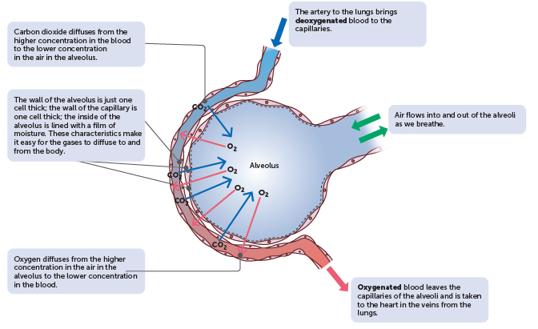
4.3 Gas exchange
The process of gas exchange
Gas exchange between alveolar air and blood

Slide 13
4.3 Gas exchange
For diffusion of gases into and out of the blood, there must be a concentration gradient – a difference in gas concentration between the air in the alveoli and the blood in the capillaries. The concentration gradient for oxygen and carbon dioxide is maintained by:
the constant flow of blood through the capillaries. As the blood flowing through the capillaries around each alveolus picks up oxygen and loses carbon dioxide, it is replaced by more blood being pumped into the capillaries. This ‘new’ blood is low in oxygen and high in carbon dioxide, so the concentration gradient is maintained
the movement of air into and out of the alveoli as we breathe in and out. The air that has picked up carbon dioxide from, and lost oxygen to, the blood is replaced by ‘new’ air with each breath. The ‘new’ air is low in carbon dioxide and high in oxygen.
Notes:
<insert diagram – reuse Fig 4.7, p. 92, Human Perspectives ATAR Units 1 & 2, 8e, 9780170449090>

Slide 14
4.4 Some effects of lifestyle and environment on gas exchange
Emphysema
Emphysema is a disease usually caused by long-term exposure to irritating particles in the air taken into the lungs, such as tobacco smoke. People who work in high-dust conditions or live in cities with high air pollution are also at greater risk.
The irritating particles cause damage to the alveoli. They lose their elasticity, are often replaced with fibrous tissue, and may break down, reducing the internal surface area of the lung. Because of the loss of elasticity of the lung tissue, the lungs are constantly inflated, and breathing out no longer occurs passively but requires voluntary effort.
The emphysema sufferer has two problems – inadequate surface area for gas exchange, and difficulty in ventilating the lungs. Emphysema cannot be cured, and once lung damage begins, the progression of the disease cannot be stopped.

Slide 15
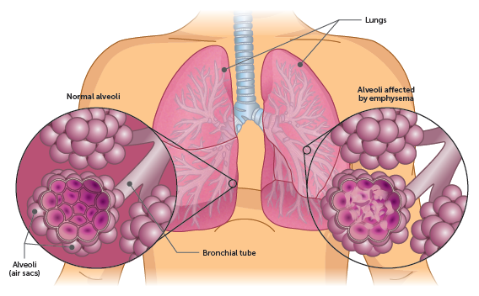
4.4 Some effects of lifestyle and environment on gas exchange
Normal alveoli compared to alveoli affected by emphysema

Slide 16
4.4 Some effects of lifestyle and environment on gas exchange
Lung cancer
Lung cancer involves the development of a mass of cells that divides in an uncontrolled way – a tumour.
There are clear links between lung cancer and exposure to asbestos fibres and other pollutants. However, tobacco smoking poses by far the greatest risk for lung cancer.
The most common form of lung cancer begins in the walls of the air passages, usually the bronchi. Inhaled smoke particles constantly irritate the mucous membrane that lines the air passages, resulting in excessive production of mucus. Cells at the base of the membrane begin to divide more rapidly and the accumulating mucus cannot be removed. The trapped mucus causes rupture of the alveoli. Emphysema has then developed. Ultimately, a cancerous growth develops in an air passage and may spread to other parts of the body.

Slide 17
4.4 Some effects of lifestyle and environment on gas exchange
Lung infections
Pneumonia is an infection of the lungs caused by bacteria, viruses, fungi or other organisms. The inflammation resulting from the infection causes secretion of fluid and mucus into the alveoli, reducing the amount of air that they can contain. The surface area available for exchange of gases is also reduced, and breathing difficulty is a symptom of many types of pneumonia.
Tuberculosis (TB) is an infection, usually of the lung, by the bacterium Mycobacterium tuberculosis. Tuberculosis, along with HIV/AIDS and malaria, is one of the top three infectious diseases causing death in the world.
Most lung infections are spread by droplets when infected people cough, sneeze or spit. Good hygiene practices help to reduce the spread of lung infections.

Slide 18
4.4 Some effects of lifestyle and environment on gas exchange
Asthma
Asthma is a medical condition that causes difficulty breathing due to a narrowing of the airways. This occurs due to:
the smooth muscles contracting, narrowing the airway
inflammation causing the lining of the airways to thicken, narrowing its diameter
mucus filling the airway, narrowing the tube.
Asthma can be an allergic response or non-allergic. Triggers for an asthma flare-up include respiratory infections, cigarette smoke, and allergens such as dust, moulds, pollens and animals.
The reduced volume of air going into and out of the lungs means that the exchange of gases is impaired, and the blood does not carry the usual amount of oxygen.

